Slide 1
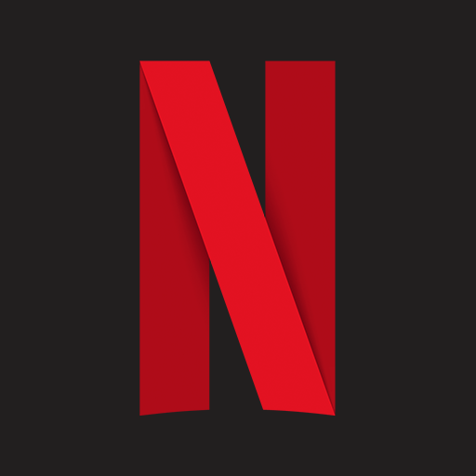
Netflix: Falling from Grace
Presented by Adam Livingston

Slide 2
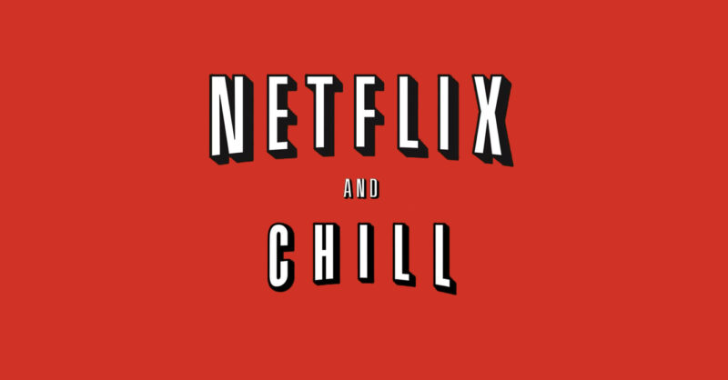
History of Netflix
Mission: Provide value to shareholders through being a premier entertainment service
1997: Online DVD rental & sales
1999: Subscription-based
2002: Initial Public Offering (IPO)
2005: Customized movie lists
2007: Online streaming service
2010: Goes international (Canada)
2013: First original series
Subscriber Count:
2006: 5M
2012: 25M
2014: 50M
2017: 100M
2021: 200M
2022: 221M
A household name and euphemism

Slide 3

Netflix: SaaS via IaaS
NIST SP 800-145: SaaS
Consumers use provider’s applications running on cloud infrastructure
Accessible from various devices
User-specific configuration settings
Multi-tenancy
Managed by single entity
SaaS

Slide 4
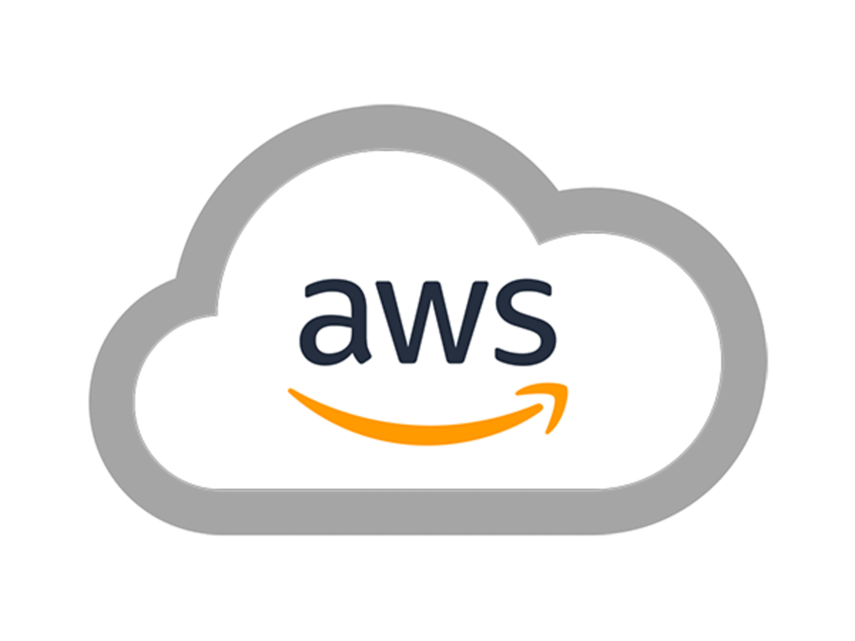
Netflix: SaaS via IaaS
AWS (IaaS) to Netflix (SaaS)
AWS – Cloud Provider
Netflix – Cloud Consumer
Netflix (SaaS) to Subscribers
Netflix – Cloud Provider
Subscriber – Cloud Consumer
IaaS
SaaS

Slide 5

Netflix’s Deployment Models
Private Cloud
Public Cloud to Subscribers
Initially traditional IT infrastructure
Transitioned to cloud in 2016
Features equally-accessible to subscribers
Available over public network (internet)
Infrastructure maintained by hosting party (AWS or Netflix)
Outsourced Private Cloud to Employees
AWS EC2 G4 instances – remote desktop streaming
Global VFX studio for collaboration
SP 500-292
Provisioned for exclusive use by a single organization
Netflix Employees

Slide 6
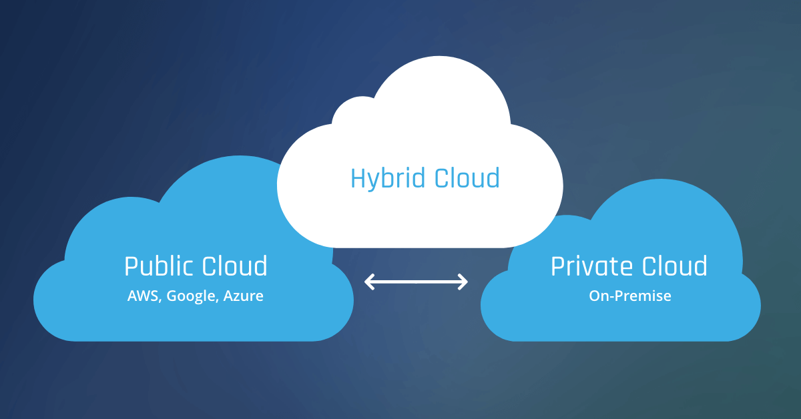
…then is it a Hybrid Cloud?
“Two or more distinct cloud infrastructures that remain unique entities”
Netflix uses AWS for nearly all computing and storage needs
Can be inferred that Private Cloud for employees interfaces with Public Cloud for subscribers
For subscribers: Public cloud
For employees: Hybrid Cloud (arguably)

Slide 7
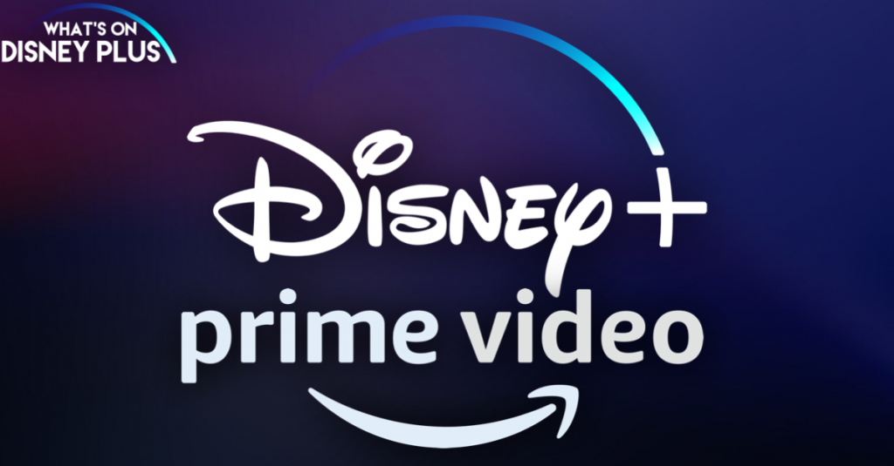
Problems for Netflix - Competition
Top 3 Streaming Services:
Netflix: 221M
Amazon Prime Video: 175M
Disney+: 137.7M
Customer Values:
Content variety and quality
Low price point
Lack of adds
Intuitive UI

Slide 8

Problems for Netflix - Pricing
For Premium Subscription:
2013-15: $11.99
2017: $13.99
2019: $15.99
2020: $17.99
2022: $19.99
Standard plans:
2013: 66% cost of premium plan
2022: 76% cost of premium plan
$2 cost increase for premium plan enacted 14 January ‘22:
Q1 subscriber loss: 200k
14 Jan Stock: $525.69
26 Jan Stock: $359.70
31.5% stock value loss

Slide 9

Problems for Netflix - Policies
19 Apr ’22 Shareholder Meeting
Ad-supported plans announced
Poor messaging
Interpreted by subscribers as all plans would contain ads
Password sharing crackdown
Poor messaging again
First among major streaming services to do so
Unclear how Netflix will define “password sharing”
Announcement made, but policies not yet enacted:
19 Apr Stock: $348.61
20 Apr Stock: $226.19
35% stock value loss

Slide 10

Summary
Excellent infrastructure, poor business model
SaaS model for subscribers
IaaS model for Netflix (patronage to AWS)
Public and Hybrid Cloud deployment models
Insufficient information on data breaches
Available data shown not to be an issue for subscriber count
Pursuit of $ via squeezing customers = loss of $
Stock High vs. Today (22 Jan ’22)
Nov ’21: $700.99
Today: $178.89
Loss in 7 months: 74.5%
“We’re doing what we learned in business school!”

